Slide 1
Ukraine begs for help!
The main thing is to start, to declare the necessary issues.
I will try to connect, but as everything will be fine, half an hour ago shells flew under the windows,
hit somewhere near, as if not in the house. But we are on the balcony without windows,
the window in the kitchen is a bit damaged, but we are alive, thank God, although our hands and feet are still shaking.

Slide 2
Чернігів

Slide 3
Чернігів

Slide 4
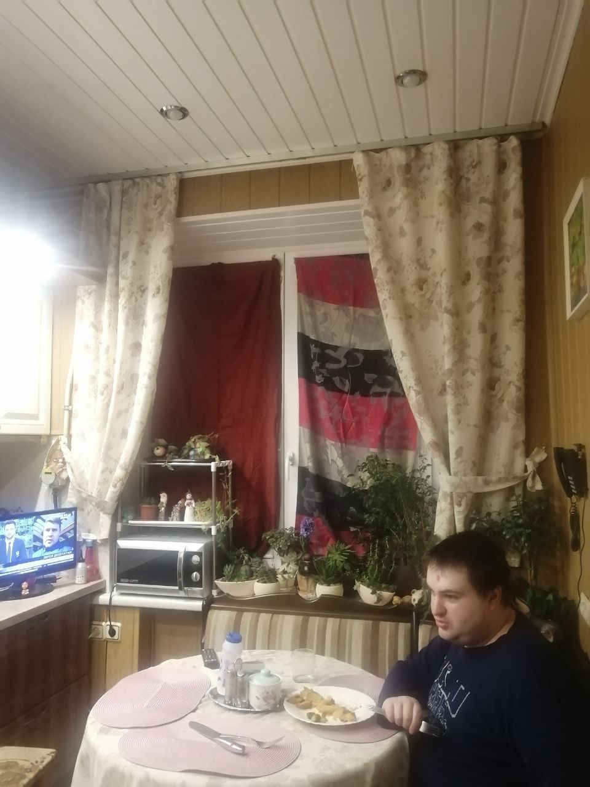
Київ

Slide 5
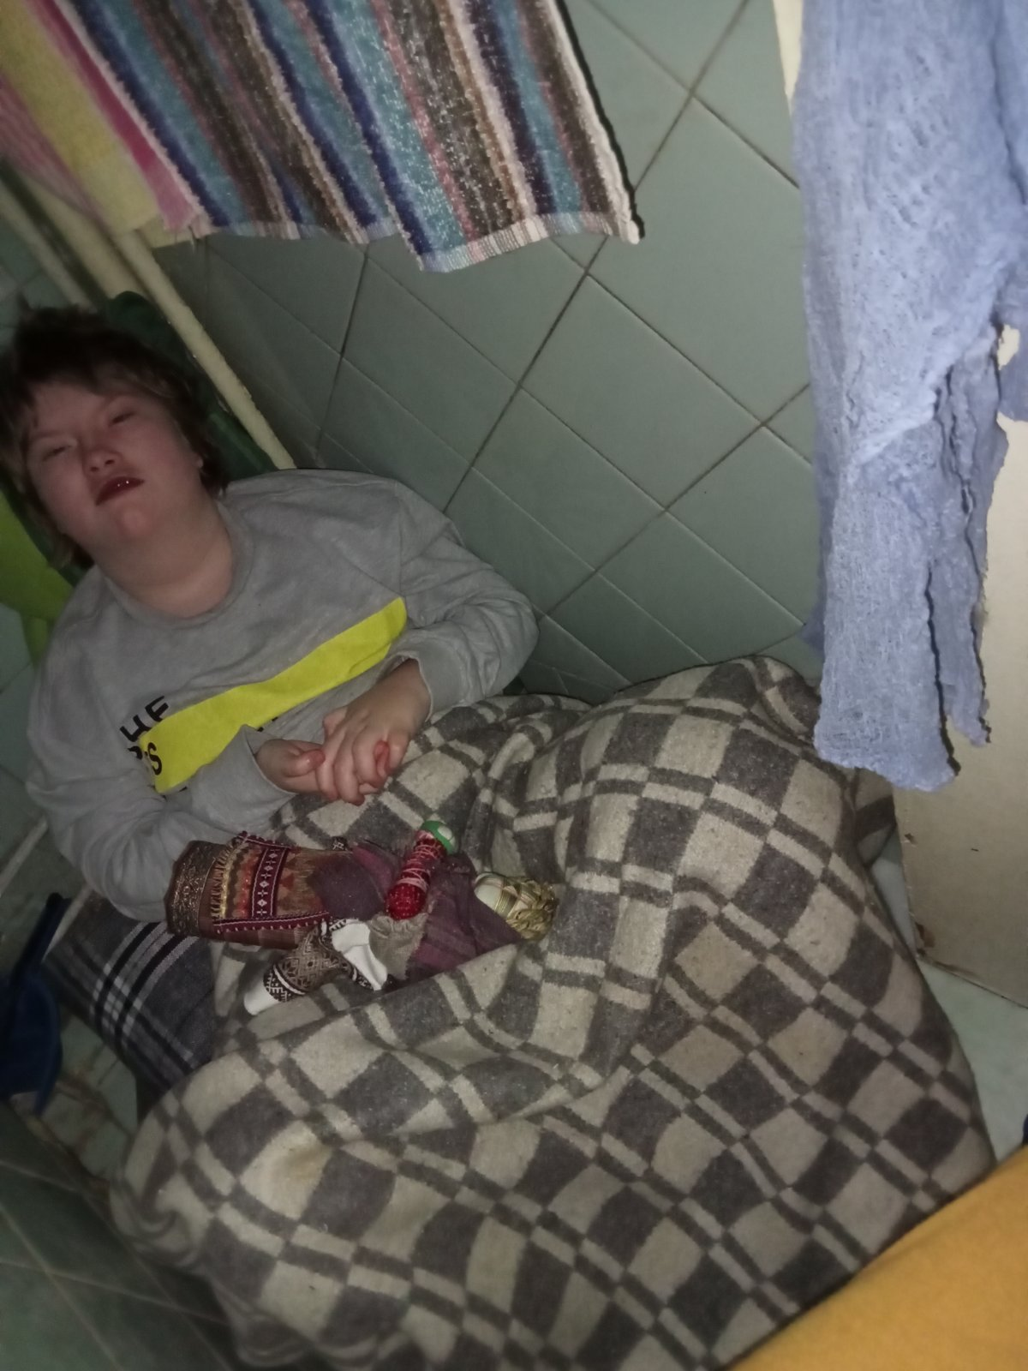
Київ

Slide 6
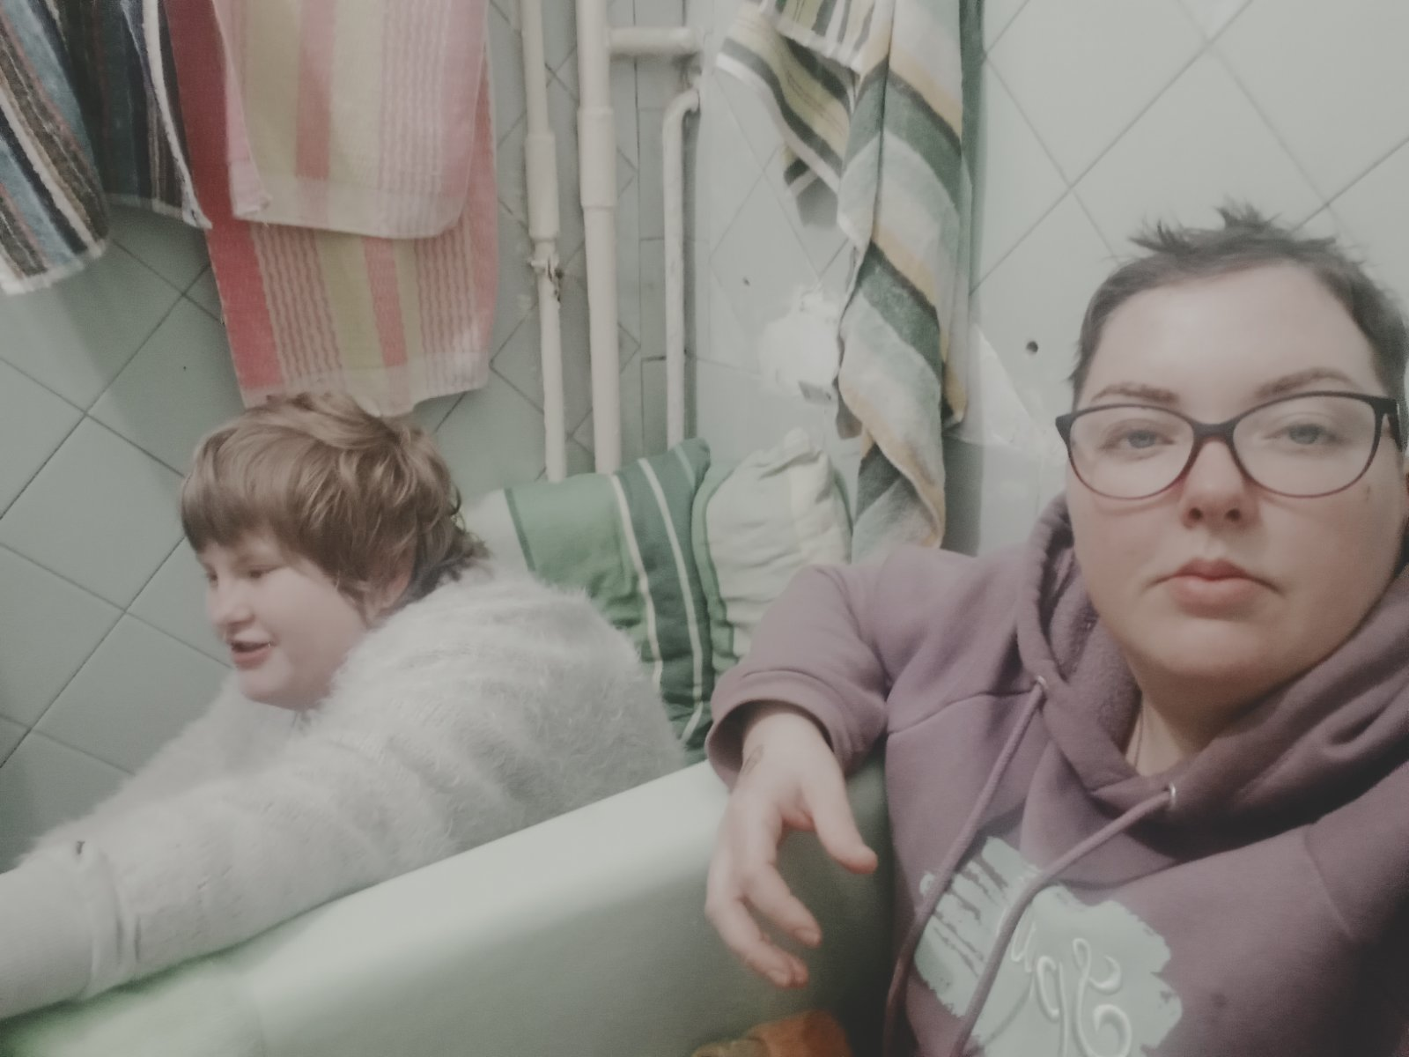
Київ

Slide 7
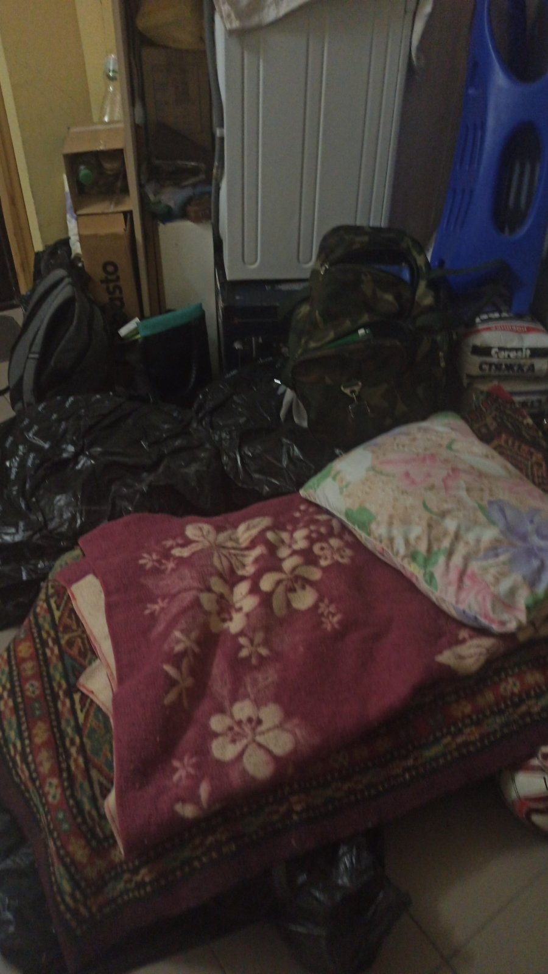
Київ

Slide 8
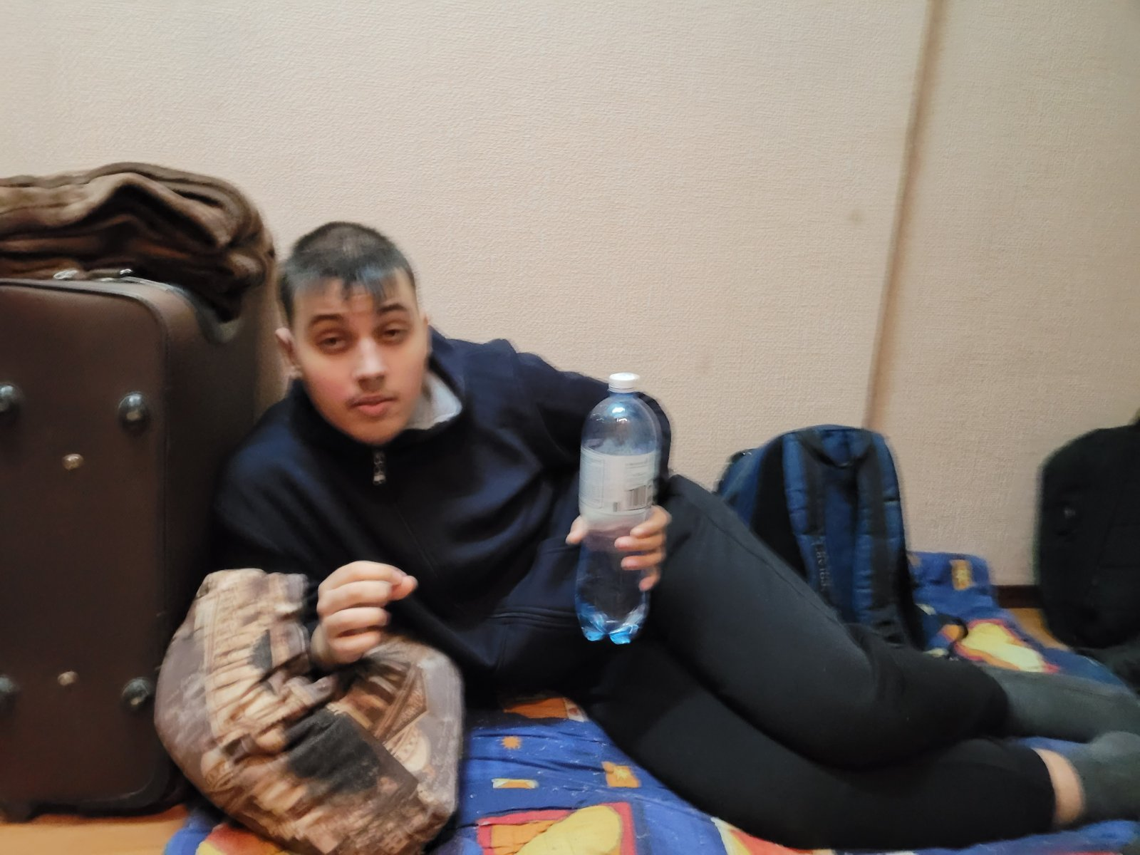
Київ

Slide 9
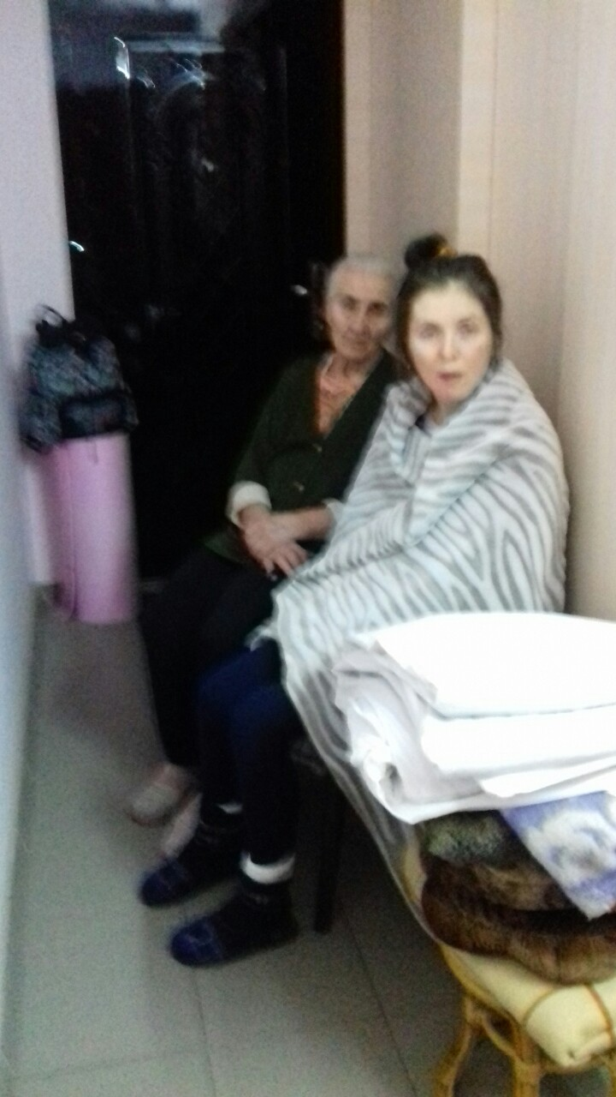
Київ

Slide 10
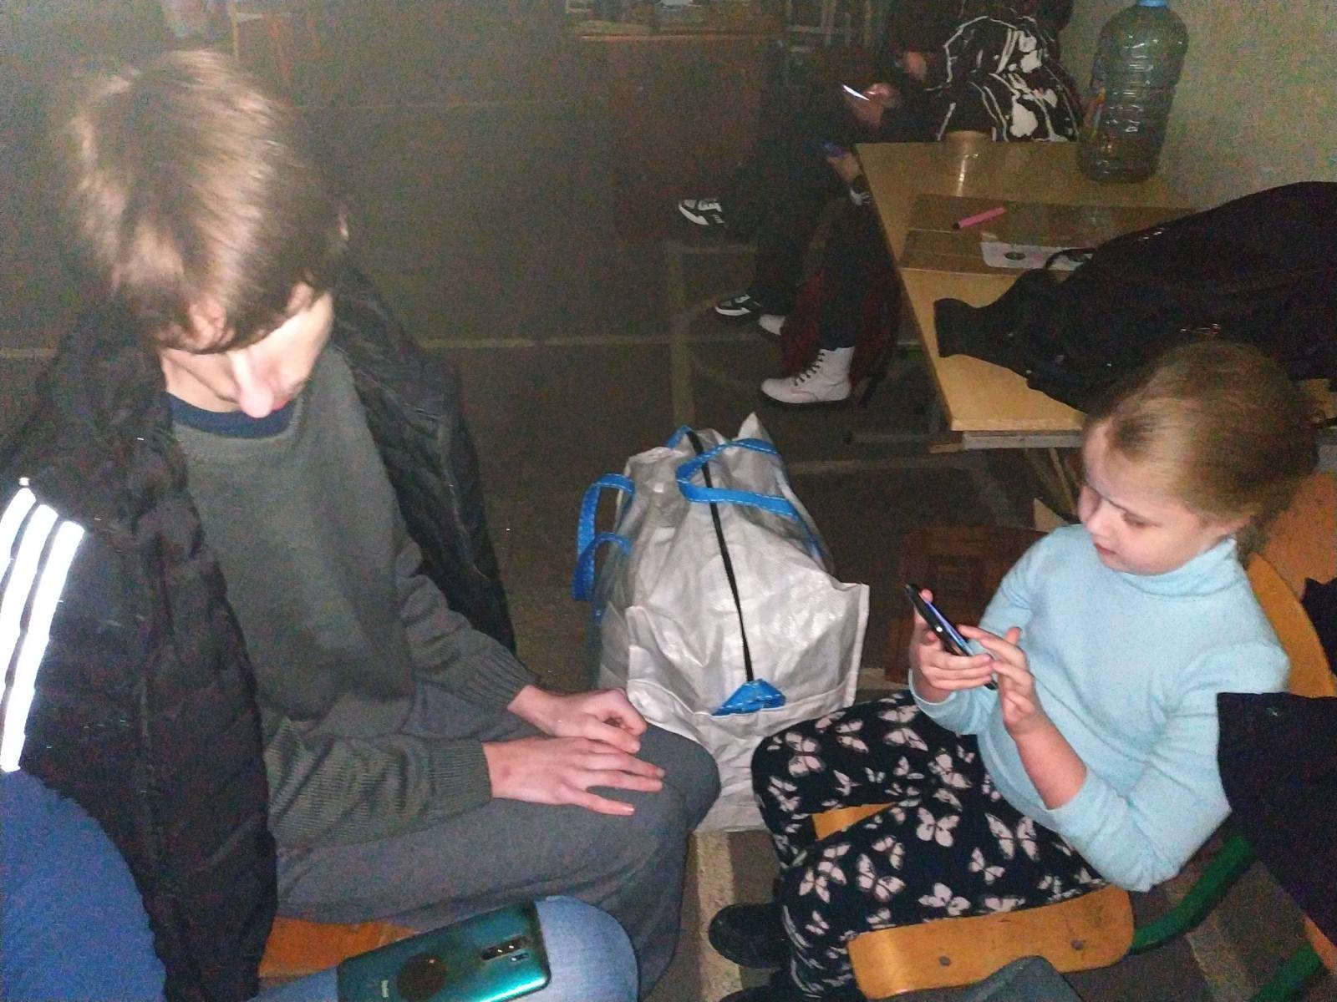
Київ

Slide 11
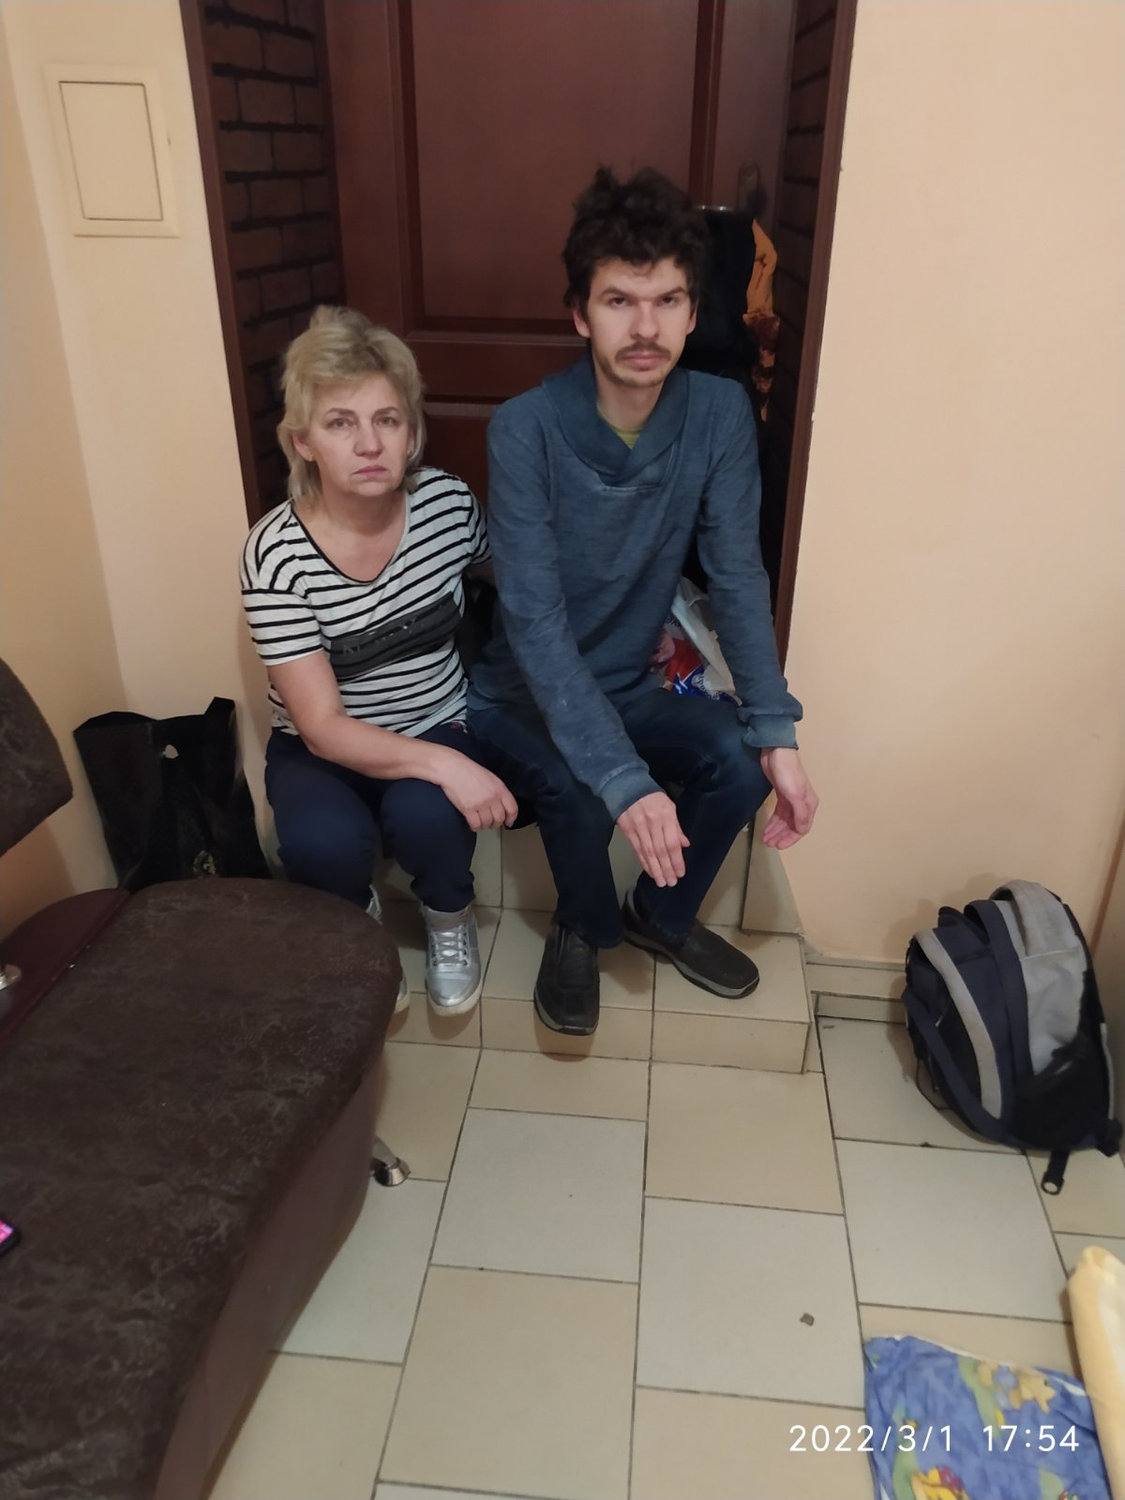
Київ

Slide 12
Київ

Slide 13
Київ

Slide 14
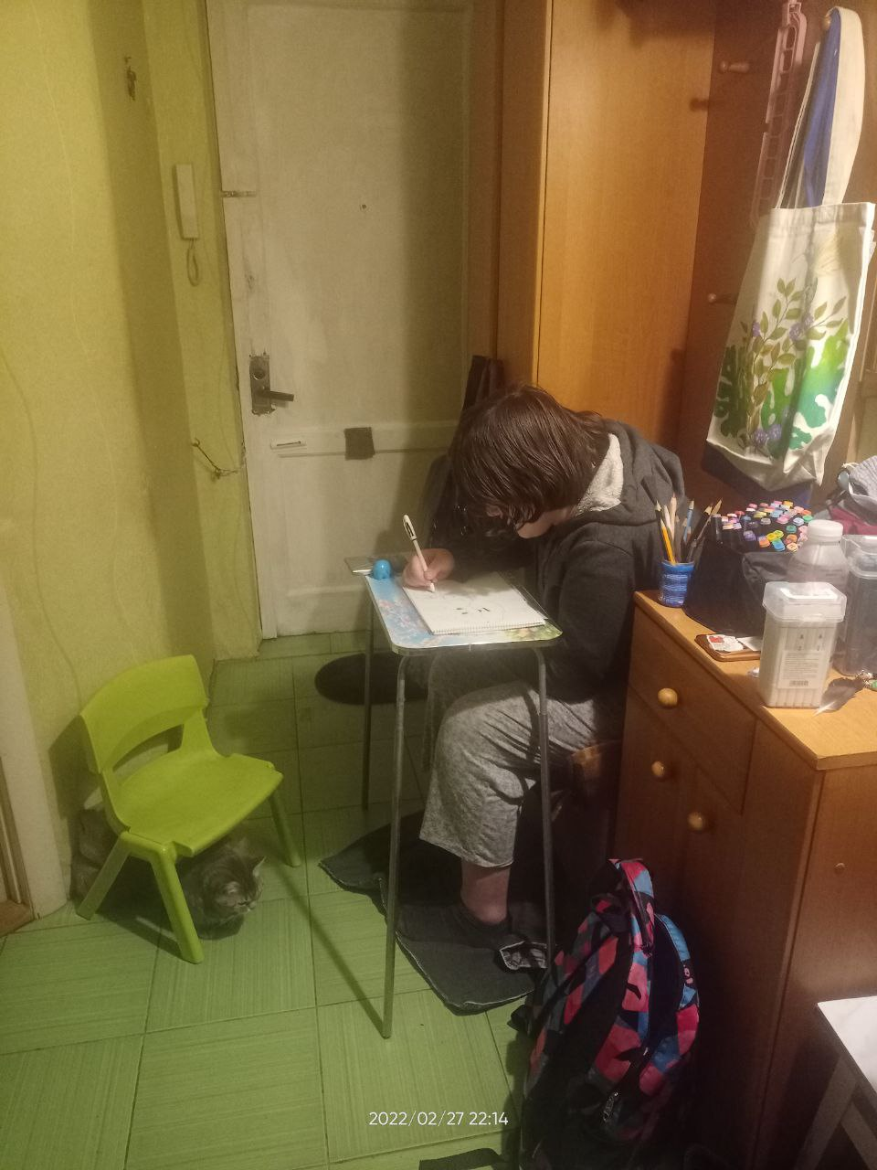
Запоріжжя

Slide 15
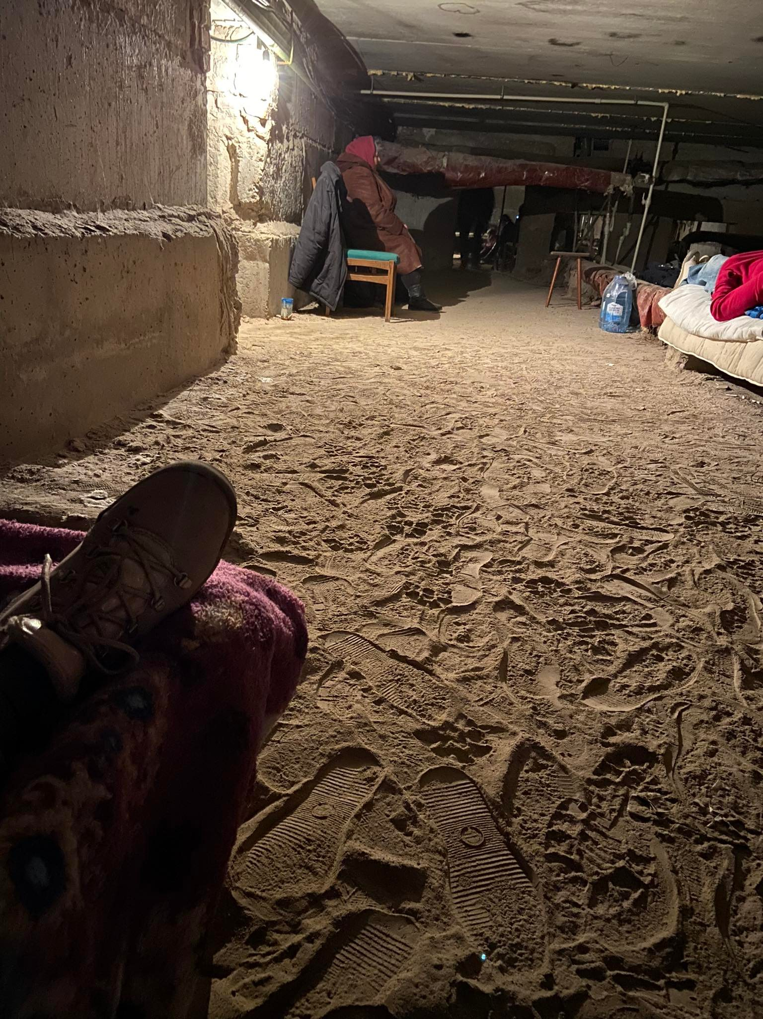
Запоріжжя

Slide 16
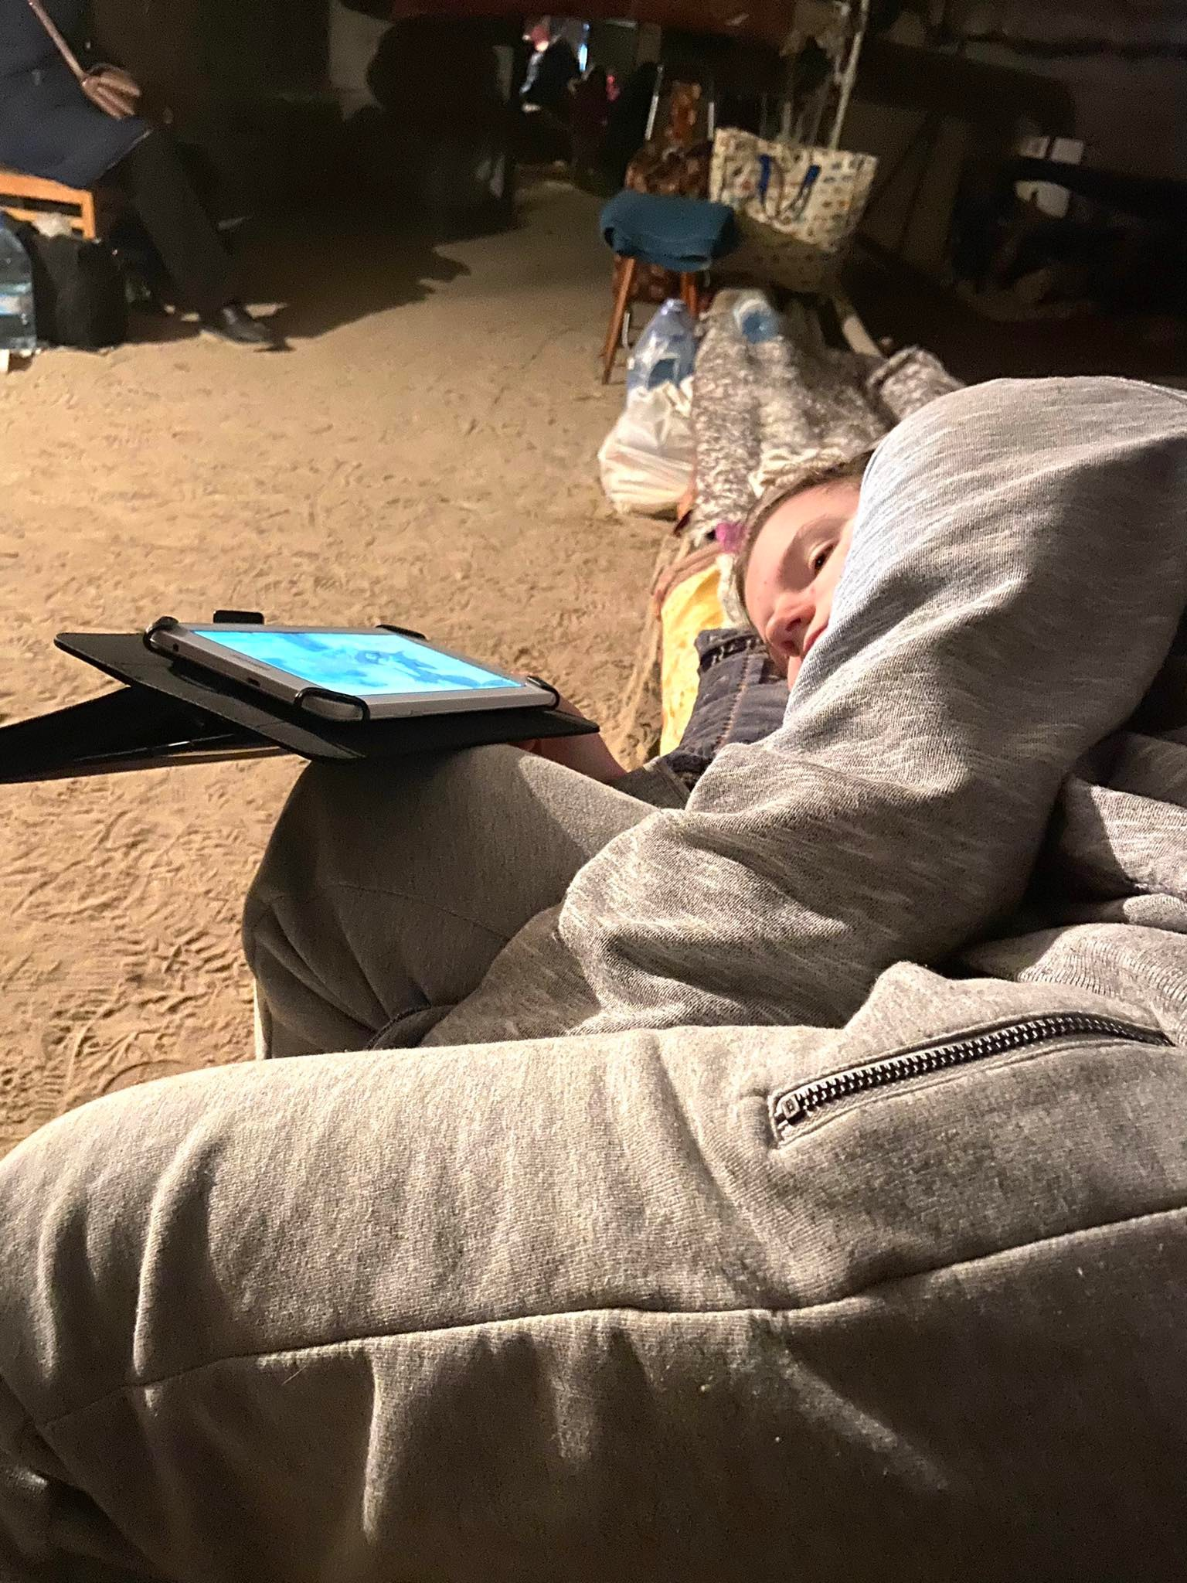
Запоріжжя

Slide 17
UKRAINE
HELP!!!
We are dying!
Do something!
You can be next!

